Slide 1

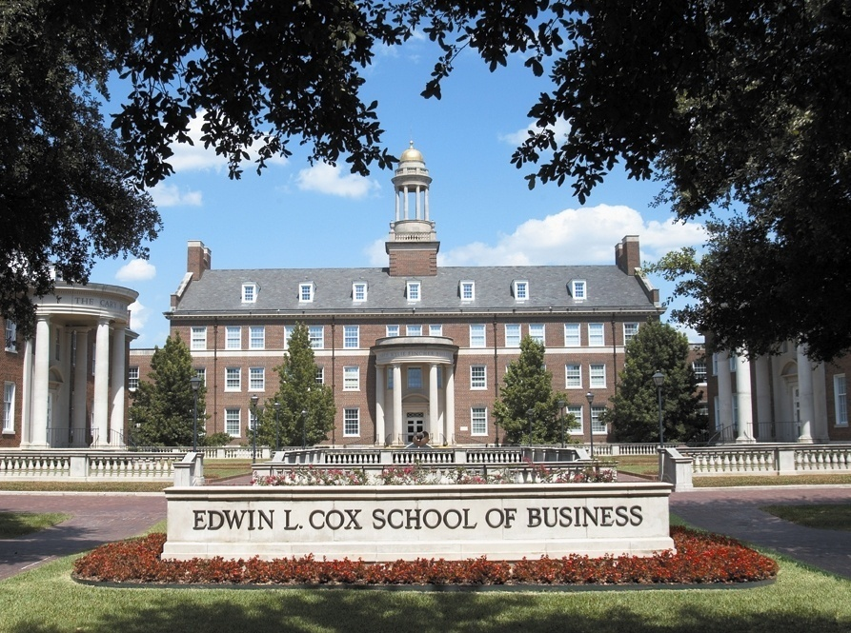
Lecture Topic 9: Risk and Return
Lessons from Market History
Presentation to Cox Business Students
FINA 3320: Financial Management
Presentation to Cox MBA Students
FINA 6214: International Financial Markets

Slide 2
Risk and Return
Lessons from Market History
What is the Probability of an investment’s price or return going up or down?

Slide 3
Risk, Return and Financial Markets
We can examine historical returns in the financial markets (e.g., stocks and bonds) to help us determine the appropriate returns on non-financial assets
Lessons from capital market history
  There is a reward for bearing risk
  The greater the potential reward, the greater the risk
  This is called the risk-return trade-off

Slide 4
Returns
Return on investment
  Gain or loss from an investment
  Two components include:
    (1) Income component (dividend or interest)
    (2) Price change (capital gain or loss)

Slide 5
Stock Returns
Dollar Returns
  the sum of the cash received and the change in value of the asset, in dollars.
Dividends
Ending market value
Time
0
1
Percentage Returns
  the sum of the cash received and the change in value of the asset divided by the initial investment.
Initial investment

Slide 6
Stock Returns
Dollar Return
  Measure of how much money you make on investment
    Capital Gain (Loss) is price appreciation (depreciation) on the stock
Percentage Return
  Rate of return for each dollar invested

Slide 7
Example: Calculating Stock Returns
Suppose you bought 100 shares of Wal-Mart (WMT) one year ago today at $25 per share
  Over the last year, you received $20 in dividends (i.e., $0.20 per share x 100 shares)
  At end of the year, the stock is selling for $30 per share
How did you do?
  Amount invested = $2,500 ($25/share x 100 shares)
  Dividend income = $0.20/share x 100 shares = $20
  Capital gains = [$30/share x 100 shares] - $2,500 = $500

Slide 8
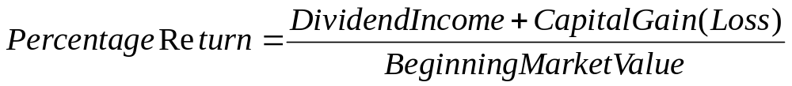
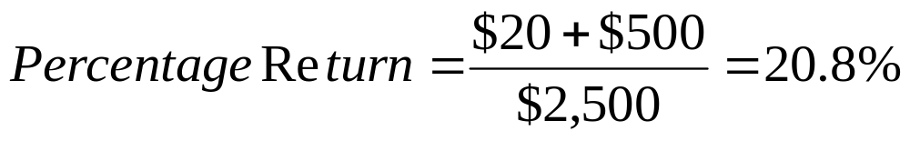
Example: Calculating Stock Returns
It appears you did quite well!
Dollar Return
Percentage Return

Slide 9
Example: Calculating Stock Returns
Dollar Return:
  $520 gain
$20
$3,000
Time
0
1
Percentage Return:
$520
-$2,500
20.8% =
$2,500

Slide 10
Holding Period Returns
The holding period return is the return that an investor would get when holding an investment over a period of t years, when the return during year i is given as R_{i}:

Slide 11
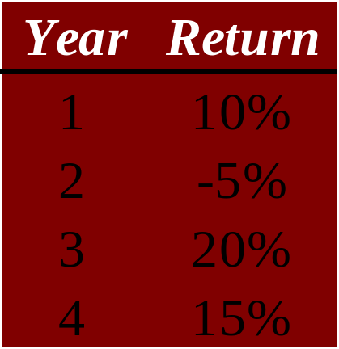
Example: Holding Period Returns
Suppose your investment provides the following returns over a four-year period:

Slide 12
Holding Period Returns
A famous set of studies dealing with rates of return on common stocks, bonds, and T-bills
  Conducted by Roger Ibbotson and Rex Sinquefield
Present year-by-year historical rates of return starting in 1926 for:
  Large-company Common Stocks (large cap)
  Small-company Common Stocks (small cap)
  Long-term Corporate Bonds
  Long-term U.S. Government Bonds (T-bonds)
  U.S. Treasury Bills (T-bills)

Slide 13
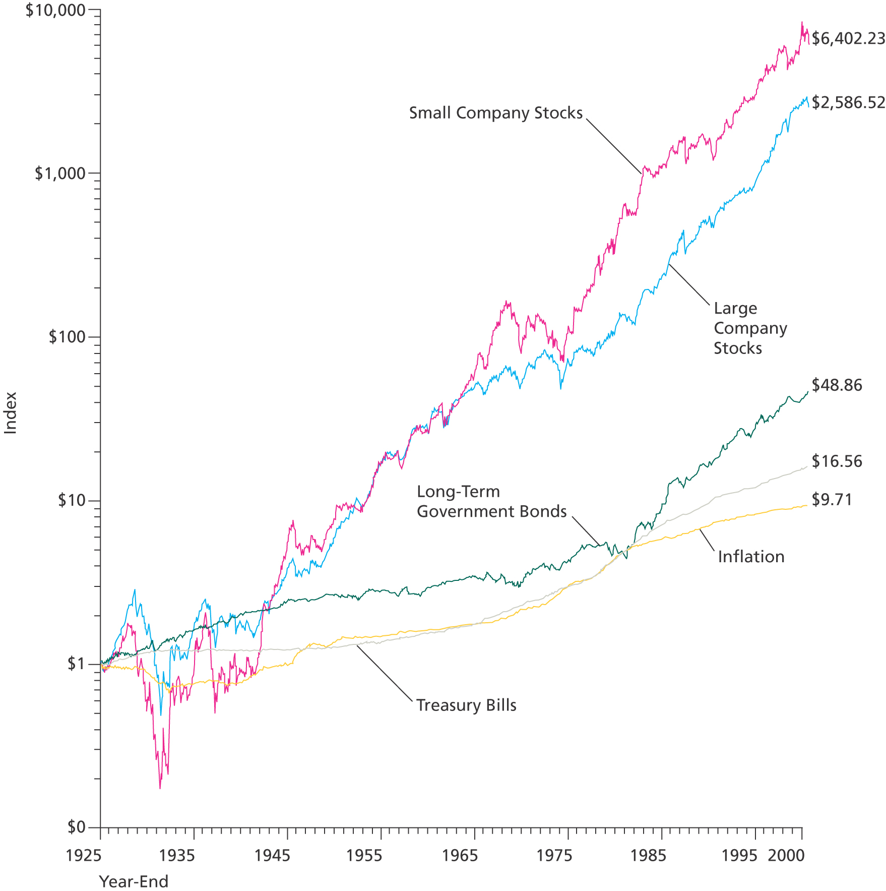
Dollar Returns: 1926 – 2000

Slide 14
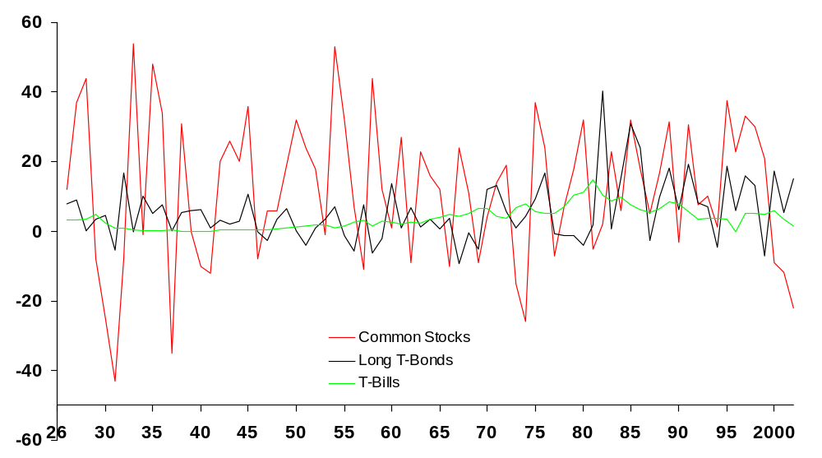
Rates of Returns:1926 – 2002
Source: © Stocks, Bonds, Bills, and Inflation 2000 Yearbook™, Ibbotson Associates, Inc., Chicago (annually updates work by Roger G. Ibbotson and Rex A. Sinquefield). All rights reserved.

Slide 15
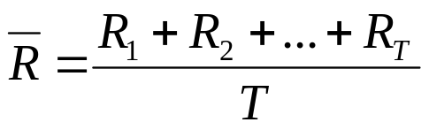
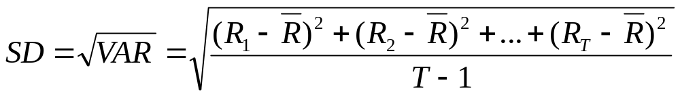
Return Statistics
The history of capital market returns can be summarized by describing the following:
  Average Return
  Standard Deviation of Returns
  Frequency Distribution of Returns

Slide 16
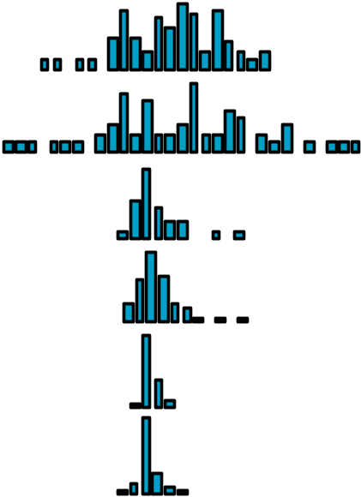
Historical Returns: 1926-2005
Average Standard
Series Annual Return Deviation Distribution
Large Company Stocks 12.3% 20.2%
Small Company Stocks 17.4 32.9
Long-Term Corporate Bonds 6.2 8.5
Long-Term Government Bonds 5.8 9.2
U.S. Treasury Bills 3.8 3.1
Inflation 3.1 4.3
– 90%
0%
+ 90%
Source: © Stocks, Bonds, Bills, and Inflation 2006 Yearbook™, Ibbotson Associates, Inc., Chicago (annually updates work by Roger G. Ibbotson and Rex A. Sinquefield). All rights reserved.

Slide 17
Historical Returns
We see big differences in average realized returns across assets over the last 80 years
But risk also differed
  How can we evaluate risk?
Many people think intuitively about risk as the possibility of an outcome which is worse than what they anticipated

Slide 18


Average Stock Returns and Risk-Free Returns
The Risk Premium
  The added return (over and above the risk-free rate) resulting from bearing risk
  One of the most significant observations of stock market data is the long-run excess of stock return over the risk-free return
    Average excess return from large company common stocks for the period 1926 through 2005 was:
    Average excess return from small company common stocks for the period 1926 through 2005 was:

Slide 19

Risk Premia
Suppose that The Wall Street Journal announced that the current rate for one-year Treasury bills (T-bills) is 5%
What is the expected return on the market of small-company stocks?
  Recall the average excess return on small company stocks for the period 1926 through 2005 was 13.6%
  Given a risk-free rate of 5%, we have an expected return on the market of small-company stocks of:

Slide 20
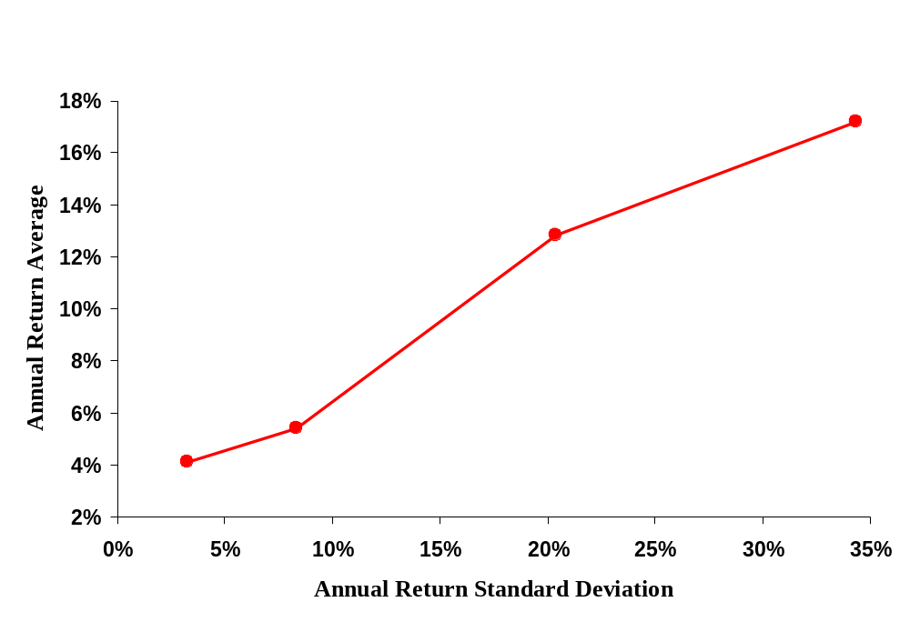
The Risk-Return Tradeoff

Slide 21
Risk Statistics
There is no universally accepted definition of risk
A useful construct for thinking rigorously about risk is the probability distribution
  Provides a list of all possible outcomes and their probabilities

Slide 22
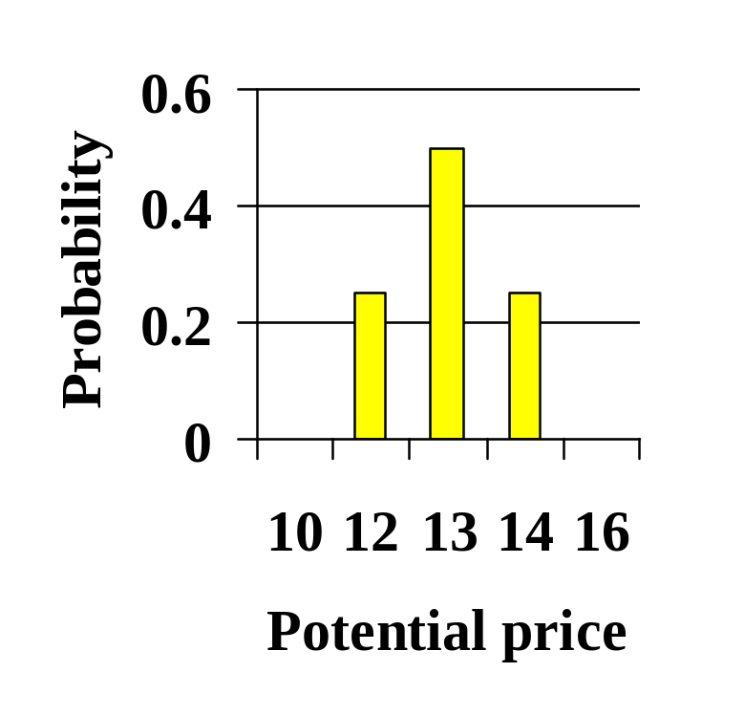
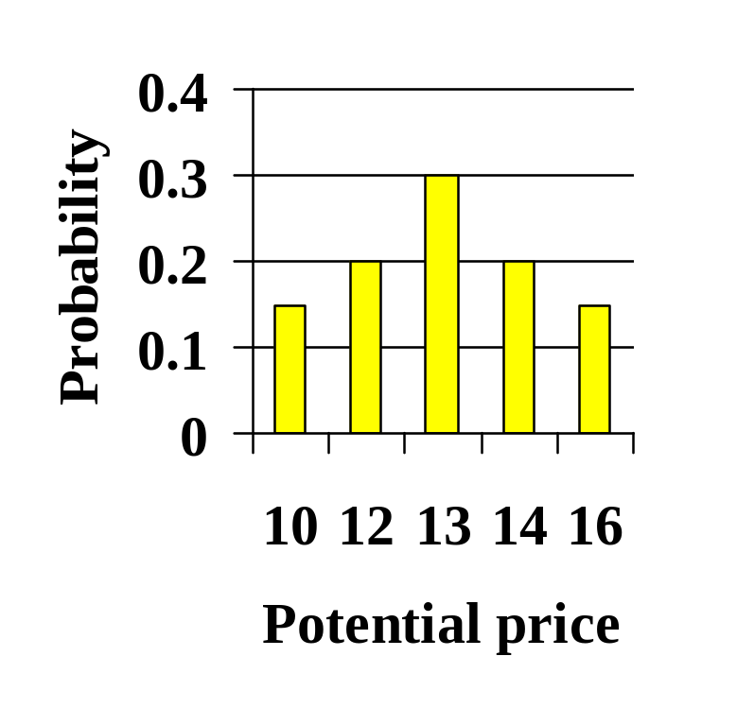
Risk Statistics
Example: Two Probability Distributions on tomorrow’s share price
  If the price today is $13 per share, which distribution implies more risk?

Slide 23
Risk Statistics
The measures of risk that we discuss are variance and standard deviation
  The standard deviation is the standard statistical measure of the spread of a sample
  The standard deviation will be the measure we use most of the time
  The standard deviation’s interpretation is facilitated by a discussion of the normal distribution…

Slide 24
Normal Distribution
A large enough sample drawn from a normal distribution looks like a bell-shaped curve
Probability
The probability that a yearly return will fall within 20.2 percent of the mean of 12.3 percent will be approximately 2/3.
– 3σ
– 48.3%
– 2σ
– 28.1%
– 1σ
– 7.9%
0
12.3%
+ 1σ
32.5%
+ 2σ
52.7%
+ 3σ
72.9%
Return on
large company common
stocks
68.26%
95.44%
99.74%

Slide 25


Normal Distribution
Interpretation of standard deviation
  The 20.2% standard deviation we found for large stock returns from 1926 through 2005 can be interpreted as follows:
  If stock returns are roughly normally distributed, the probability that a yearly return will fall within 20.2% of the mean return of 12.3% will be approximately 2/3
    About 2/3 of the yearly returns will be between -7.9% and 32.5%

Slide 26
Risk Statistics
Calculating sample statistics
  When we want to describe the returns on an asset (e.g., a stock), we usually don’t really know that actual probability distribution
  However, we typically have observations of returns from the past
    That is, we have some observations drawn from the probability distribution
  We can estimate the variance and expected return using the arithmetic mean of past returns and the sample variance

Slide 27
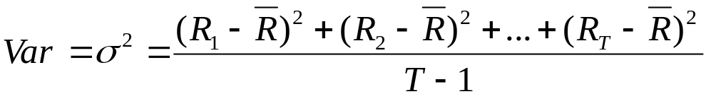
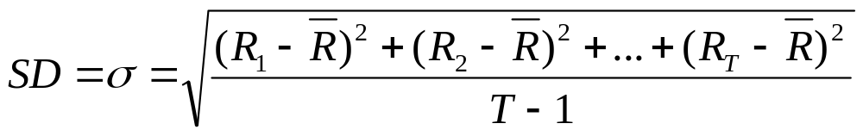
Risk Statistics
Calculating sample statistics
  Mean, or Average, Return
  Sample Variance
  Sample Standard Deviation

Slide 28
Risk Statistics
Example: Return, Variance, and Standard Deviation
Year | Actual Return | Average Return | Deviation from the Mean | Squared Deviation
1 | .15 | .105 | .045 | .002025
2 | .09 | .105 | -.015 | .000225
3 | .06 | .105 | -.045 | .002025
4 | .12 | .105 | .015 | .000225
Totals |  |  | .00 | .0045
Variance = .0045 / (4-1) = .0015 Standard Deviation = .03873

Slide 29
More on Average Returns
Arithmetic Average
  Return earned in an average period over multiple periods
Geometric Average
  Average compound return per period over multiple periods
The geometric average will be less than the arithmetic average unless all the returns are equal

Slide 30
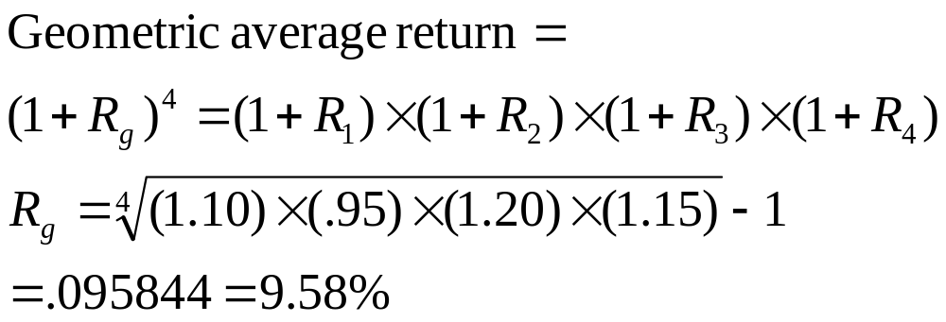
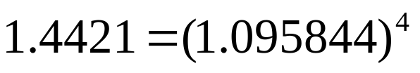
Example: Geometric Returns
Recall our earlier example:
  So, our investor made an average of 9.58% per year, realizing a holding period return of 44.21%

Slide 31
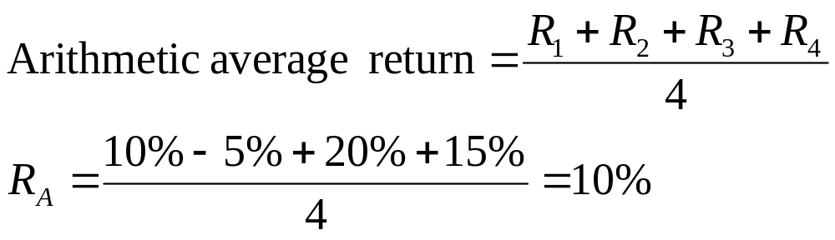
Example: Arithmetic Returns
Note that the arithmetic average is not the same as the geometric average
  So, the investor’s return in an average year over the four year period was 10%

Slide 32
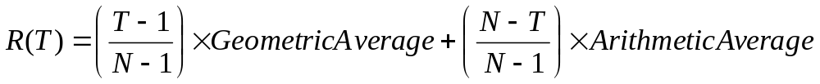
Forecasting Return
Blume’s formula
  Arithmetic average overly optimistic for long horizons
  Geometric average overly pessimistic for short horizons
  Blume’s formula is a simple way to combine both!
    Where T is the forecast horizon and N is the number of years of historical data we are working with
    T must be less than N

Slide 33
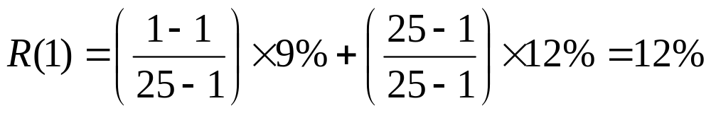
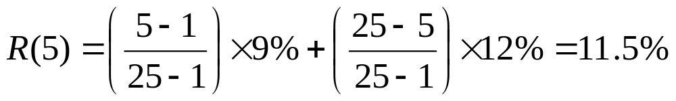
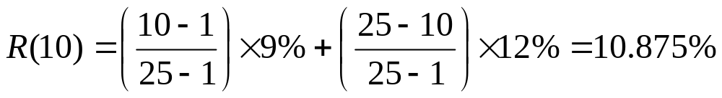
Forecasting Return
Example: Blume’s formula
  Suppose from 25 years of data we calculate arithmetic average of 12% and geometric average of 9%
  From these averages, we can make 1-year, 5-year, and 10-year average return forecasts:

Slide 34
Thank You!
Charles B. (Chip) Ruscher, PhD
Department of Finance and Business Economics

